Slide 1

Period End Closing Key Process Areas and New Period End Checks
Monthly Accrual Run
Period End Closing for Accruals and Recurring Entries
Monthly Recurring Entries Posting

Slide 2
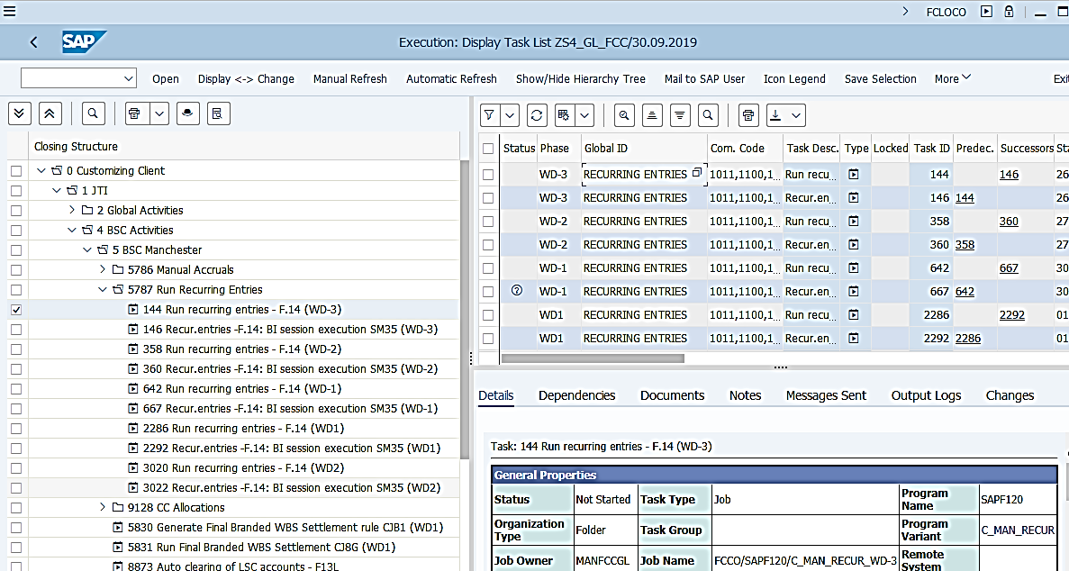
Monthly Recurring Entries Posting (1/3): Overview
Basic Recurring Entries Process
Create Recurring Document during the month
Periodic run for Recurring Entries
Define the document header and line items that are to be re-used periodically for generating actual postings.
Define the posting date and posting intervals of the periodic postings.
Monthly execution of the selected Recurring Entries, generating accounting document for a given posting period.
T-Code: F.14
The Monthly Recurring Entries Posting run posts the actual accounting document for the period using selected valid Recurring Entries documents as reference documents. The use of T-Code F.14 remains the same in S/4 as in ECC.
It is important to note that Recurring Entries postings are ledger-through postings which impact all ledgers at the same time.
FCC Task: GBS/JTBC Level
Entities using Recurring Entries are included in the GBS/JTBC variant for F.14. Like any task set at GBS/JTBC level, you should ensure the variant has included the required entities before the tasks are due to be run.
Timing: WD-3 to WD2 daily
This is to ensure any newly created Recurring Entries can be picked up for the monthly run.

Slide 3
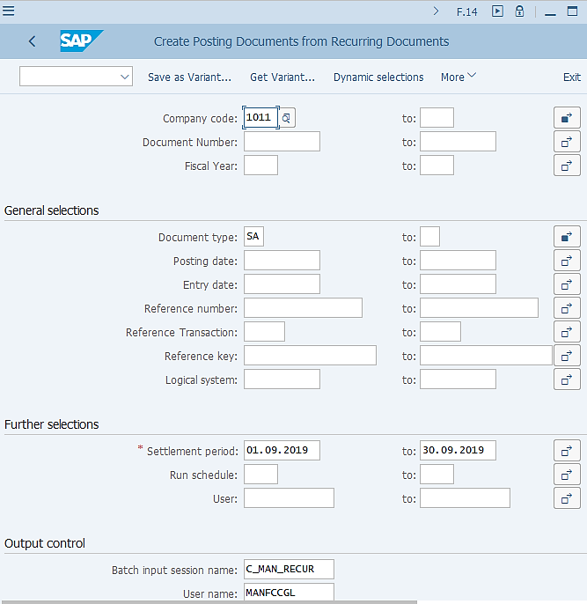
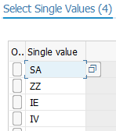
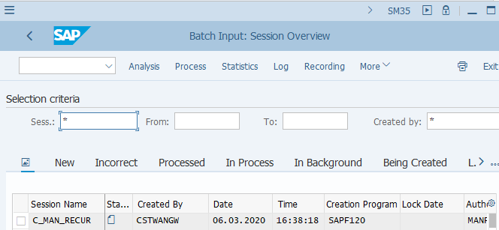
Monthly Recurring Entries Posting (2/3): Execution
F.14 - Recurring Entries Periodic Run
Remember this is a “GBS/JTBC variant” therefore Company Code field must be reviewed / amended when executed outside of FCC!
The use of T-Code F.14 remains the same in S/4 as in ECC.
There is no Ledger or Ledger Group selection in F.14 as this transaction is ledger-through, which will post the documents to all ledgers at the same time.
Some of the Recurring Entries used in ECC, which needed to be posted to specific ledger groups instead of all ledgers, are now created as Accrual Object in S/4 using the required Accounting Principles. This is due to Recurring Entries in S/4 can only be posted Ledger-through.¹⁾
There are a number of different document types included in the F.14 variants. These are Recurring Entry documents created with different types of accounts used for posting. (E.g. ZZ for Bank accounts, IE for Intercompany AP and IV for Intercompany AR)
Review/amend Company Code and Settlement Period fields before executing it outside of FCC.
Batch Input session is generated from F.14, which needs to be processed by the GBS/JTBC (or FCC if executed within FCC) via SM35.
SM35- Batch Input Session
¹⁾ Details on Recurring Entries are described in Parallel Ledger course.

Slide 4
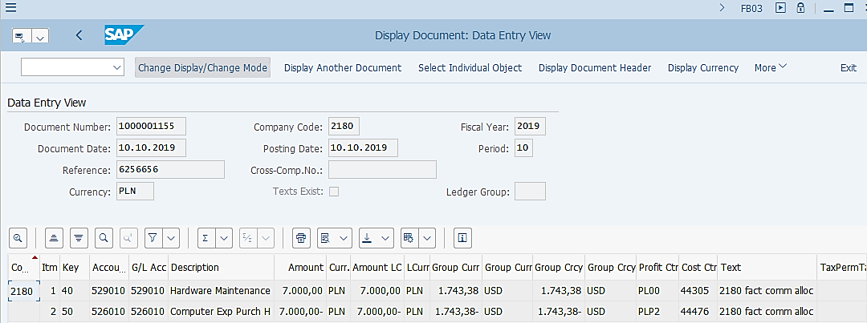
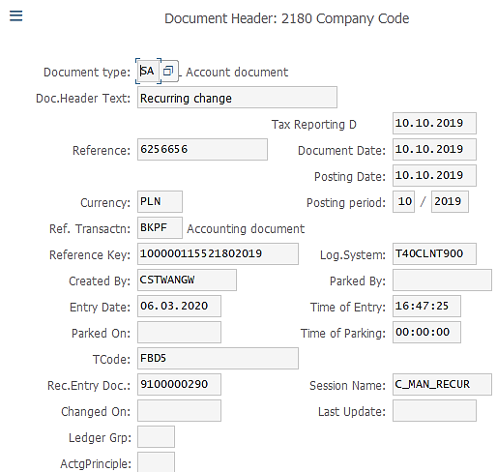
Monthly Recurring Entries Posting (3/3): Posted Documents
FB03 – Display FI Document
Posted Document from Monthly Recurring Entries Posting:
The documents posted via the Monthly Recurring Entries Posting contain information based on the selected Recurring Entry Documents data, the parameters used in the Monthly Recurring Entries Posting, as well as automatically generated information by the system.
The field Reference Rec.Entry Doc. (in Document Header) is the Recurring Entry Document Number based on which the monthly document is posted.
You should always have a Session Name, which can be used to identify which documents are posted in which Recurring Entries Posting run.
There are parameters maintained in the Recurring Entry Documents, which determine whether a Recurring Entry Document will be picked up in the periodic run and the posting intervals. Please refer to Parallel Ledger course for further details.
Legend
Automatically generated by the system
Determined by the Recurring Entry Document Data
Determined by the Monthly Recurring Entries Run execution parameter

Slide 5
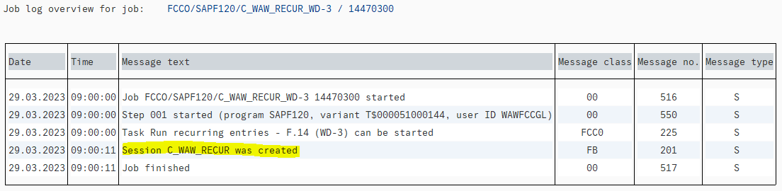
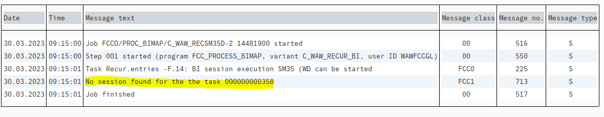
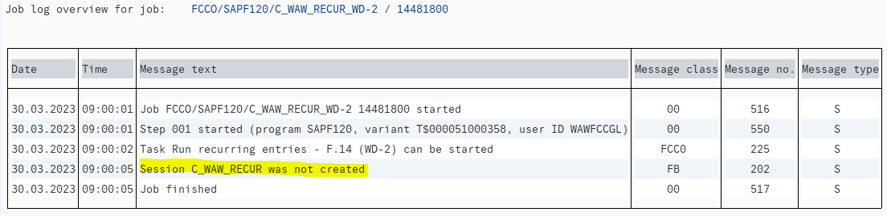
Monthly Recurring Entries Posting Common Error
Detail of the “Errors” can be checked from the “Output Logs”. GL Team needs to check the error and work as per the resolution mentioned below.
Errors | Error Description (Reason) | Resolution
Session “*******” was not created. | The status in this step is always green, but GL Team needs to check Job log because there is no information available to see if any session was generated. There should be a Session generated in the second step. If the session was not generated, the status will be green. | No action required. This is not considered as an error but be aware of this message while doing the FCC Monitoring.
No session found for the task *****. | The error message comes from job log of Post Recurring entry batch task when session is not created in the previous step “Create Recurring entries batch”. In this case there is no spool list in the output logs. | Change the status to checked with the comment “No Batch to post"

Slide 6
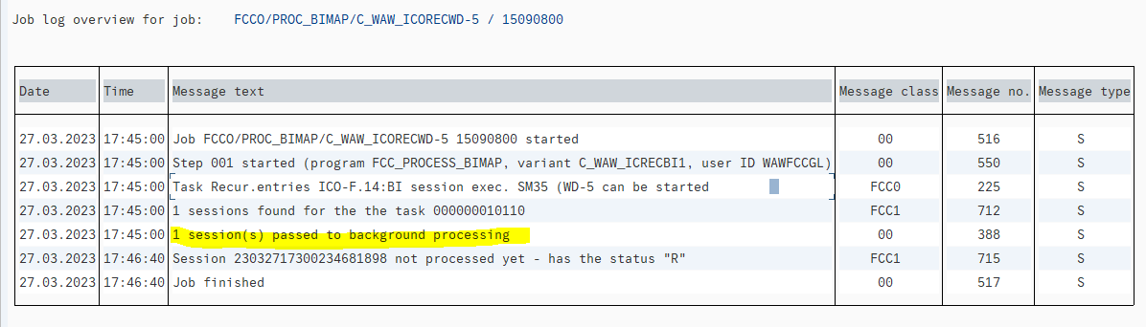
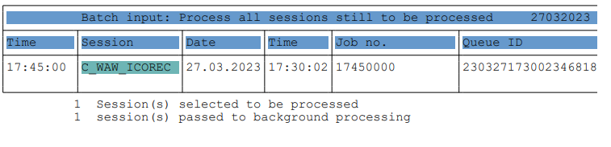
Monthly Recurring Entries Posting Common Error
Errors | Error Description (Reason) | Resolution
X session(s) have been passed to background processing. | This error comes when session was created in the first step, but in the second step the status is red. Which means Batch Input session has been generated and sent to background processing. But it does not tell us whether the processing is finished or not. | Check the session name in the spool list and find it in the T-code SM35. Tick the session and select Process -> Display errors only to process Batch. If posting has completed successfully, change the status to checked with the comment “Batch has been posted". If there is an error that is blocking posting in Inter-Company recurring, then send an e-mail to the GBS Intercompany Team with the error message, and they will advise on the next action.

Slide 7
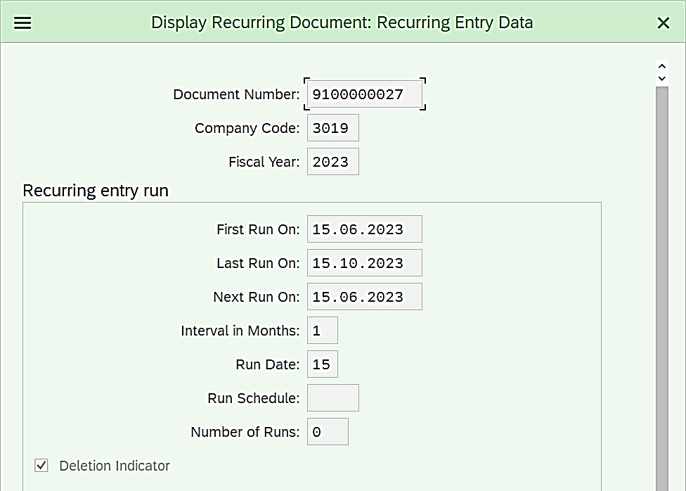
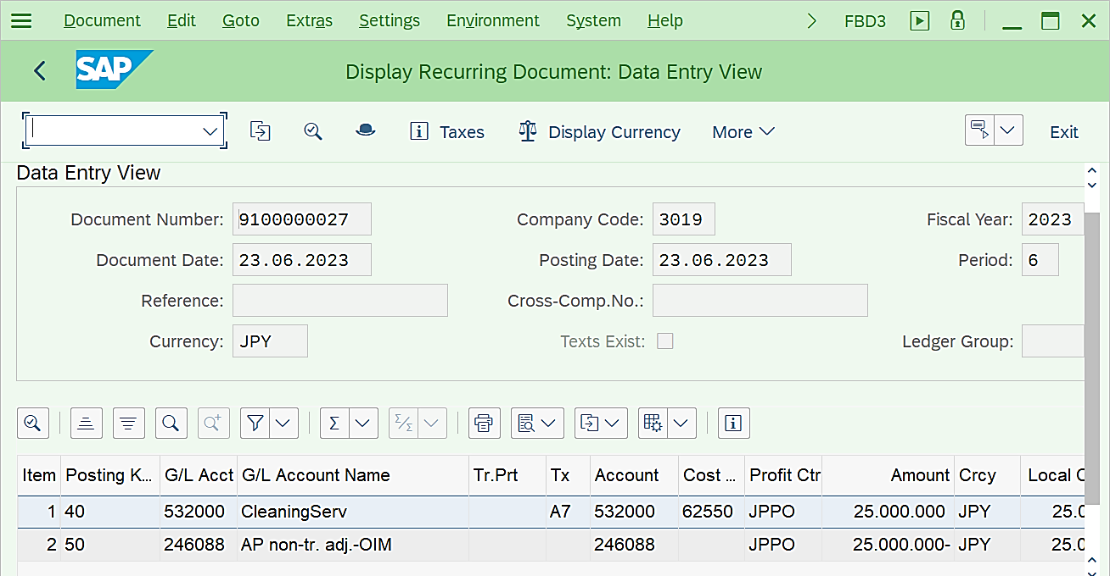
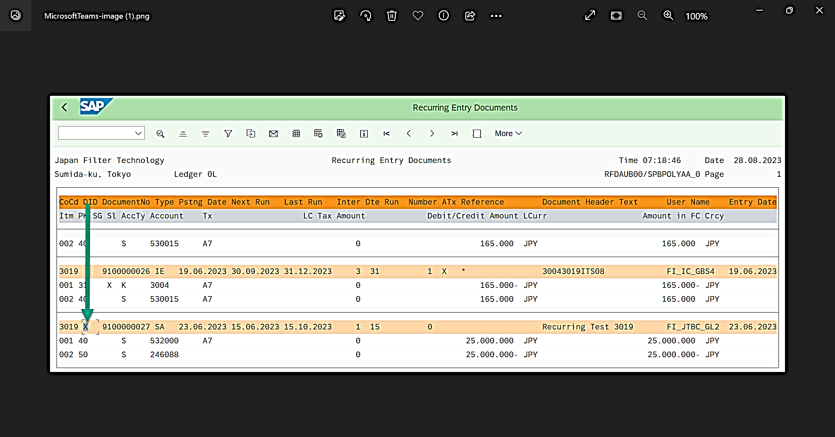
Monthly Recurring Entries Posting Common Error
Step 1: Execute the T-Code FBD3 and give the Recurring Entries document number which has not been selected.
Click on “Goto” in the menu bar and select the “Recurring Entries Data”.
Note
Check the “Deletion Indicator” is ticked, which means the document is block for posting.
Sometimes, Recurring Entries Document will not be posted because of the “Deletion Indicator” is set for that document Number. This can be checked in two possible ways.
Step 2: Execute the T-Code F.15
“DID” Stands for “Deletion Indicator”. Confirm if there is “X” for the document number.

